Slide 1
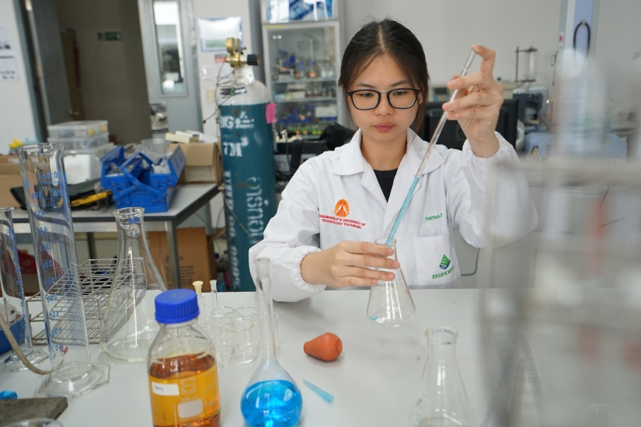
Orientation 1/2022 before research conduct
Zoom, 25 July 2022 9.30 am

Slide 2
Course works
Progress
Defense
Thesis Proposal
Graduate
Course works
- Compulsory
- Elective
-Proposal
-Course works
In each semester
After complete research work
Fulfill the requirements

Slide 3
Period of study
Master
2 years
5 years
PhD
3 years
6 years
1 year
Normal
Scholarship covered
Maximum
Scholarship not covered
Extension
(In the conditions of PhD student must passed Defence examination and waiting for the last IJ paper)
Scholarship covered only the courses in the program.
If you fail in any courses you have to pay by your own cost.

Slide 4
Withdrawal & Retention
Semester withdrawal
Pass defence exam
Waiting for publication result and / or English
Student status retention
One semester leave at a time
No more than two semesters in entire program
Semester withdrawal
Pay retention fee 4,000฿/semester
Be counted as the study period
No credit to earn
Not submit request for graduation

Slide 5
Thesis Examination
Proposal
Progress
Defence
Enrolling for thesis 1st time
CE for PhD
QE for Master & PhD
2 chances to exam
Failure in 2nd exam = retire
In each semester
Credit earn base on performance
After complete research work
Submit/publish all publication requirement
Open to public
30 mins presentation follow by Q&A.
2 chances to exam
Failure in 2nd exam = retire

Slide 6
Comprehensive Examination (CE)
Only PhD
Evaluate the student’s ability in
Analysis
Student select 3 Technical papers relate to research work
Failure in 2nd exam = retire
Synthesis of information
Identifying important issues
Making comments
Fail the examination, one more chance to take re-exam

Slide 7
Qualifying Examination (QE)
For Master and PhD
Evaluate the student’s ability in
Readiness to undertake the proposed thesis work
Fail the examination, one more chance to take re-exam
Thesis work must be original
The work should indicate some initiative, which may lead to a new concept, approach or new finding
PhD must pass the CE
Failure in 2nd exam = retire

Slide 8
Research Integrity (RI)
Graduate student who enrolls in year 2022 onwards must take theoretical training and practical training courses before taking a Qualifying Examination (QE)
Theoretical training course: A self-study online course via CITI Program (www.citiprogram.org), offered in English language.
Practical training course: Online course offered by Research, Innovation and Partnerships Office (RIPO), KMUTT. For Thai language the training will be held every month, for English language it will be held 3-4 rounds in a year. The training will be announced on RIPO website (https://ripo.kmutt.ac.th). The Academic Section of JGSEE will inform all JGSEE faculty & researcher when there is the announcement from RIPO.

Slide 9
Thesis proposal Form (AS10)
Topic & Committee name’s nominate
Objective & Methodology
Committee CV
Research Budget
Thesis abstract
Deadline of submission is on 15 August 2022

Slide 10
Thesis committees
Nominated by Advisor
Nominate in the semester student enroll Thesis for the 1st time
Master degree, require at least 3 committee members
Ph.D. degree, require at least 4 committee members
Attach CVs of all committee members (CV to include publications over past 5 years)
External Examiner
Nominated 2 names by Advisor
Nominate in the semester student ready to take defence examination
Ph.D. degree require a Professor doctor to be an external examiner
Master degree, the external examiner will be approved by Executive Board
Ph.D. degree, the external examiner will be approved by Professorial Board

Slide 11
Thesis Topic & Committees Approval
Submit proposal form (AS10) to Academic section
Executive Board Meeting
Appointment Topic & Thesis Committees
Professorial Board Meeting
within time period according to Academic Calendar (15 Aug 2022)
August 2022
September 2022
October 2022

Slide 12
Process of Examinations Proposal, Progress, Defence
Fix the Exam date with committees
Send Thesis Report to all Committees
Submit Request for Examination Form (AS14) and Report Submission Form (AS15)
Invitation to Exam
Examination Commences
Submit revised thesis report according to the examination committees comments with financial report
At least 2 weeks before exam date for Proposal & Progress, 1 month for defence. All committees need to sing in the form AS15 to ensure the readiness of examination. E-mail from committees replying is allow.
Invitation letter will be issued only when the committee has received the thesis report.
within time period according to Academic Calendar
within 30 days after examination. If over due fine 50฿/day

Slide 13
Request for Thesis Examination
Submit a request via online system:
AS14 Request for Examination Form (Online system)
Attachment 1. AS15 Report Submission Form 2. Research Integrity Certificate
Last day of submission AS14
Special Study 30 NOV 2022
Proposal (CE/QE), Progress 30 NOV 2022
Defence 7 NOV 2022

Slide 14
Request for Thesis Examination
AS14 (Online system)
Attachment AS15+RI certificate
Submit before Exam date
At least 2 weeks Proposal, Progress
At least 1 Month Defence
Otherwise not allow to exam and grade will be “U”

Slide 15
After thesis Exam
Submit revise thesis report & Financial report within 30 days after examination, if over due fine 50฿/day.
Thesis Exam (Proposal, Progress, Defence)
Revise Thesis Report
Financial Report
Submit to Academic within 30 days after examination, if over due fine 50฿/day.

Slide 16
Thesis correction after defence
1. Thesis correction according to the examination committee
2. Checking plagiarism (not over 20% of copy)
4. Thesis 1 hard copy & pdf file
3. Submit Thesis report for Checking of format & English
Master student
Within 60 days after defence, If overdue Re-exam
Link to procedure

Slide 17
Thesis correction after defence
1. Thesis correction according to the examination committee
2. Checking plagiarism (not over 20% of copy)
3. Submit 1 hard copy & pdf file
PhD student
Within 60 days after defence, If overdue Re-exam
Link to procedure

Slide 18
Modification Thesis Entitled
Thesis entitle modification can be made by the recommendation of the thesis committee. Student must submit the AS09 form to academic section
Minor modify
Approved by Head of Research Lab
Major
modify
Master degree will be approved by EB
PhD degree will be approved by EB & PB

Slide 19
Before exam
After exam
Examination
Check academic calendar
Consult adviser
Thesis report
Fix the examination date
Send thesis report to all committees
Submit Request for exam (AS14+AS15)
Examination Commences
Food & Drink
Car parking
Submit revise thesis report & Financial report within 30 days after examination, if over due fine 50฿/day.
After defence
Make thesis correction & checking plagiarism, within 60 days after defence, If over due student must re-take oral examination and register for the next semester.
Checking format.

Slide 20
Research fund
PhD
290,000฿
Master
135,000฿
Available for all students

Slide 21
Research fund
PhD
6 Installments
Master
4 Installments
1. Appointment Topic & Committees 2. Proposal 3. 1st Progress
4. 2nd Progress
5. 3rd Progress 6. Defence
1. Appointment Topic & Committees 2. Proposal 3. Progress
4. Defence

Slide 22
Graduation Requirements
1. Credits Earned
Master (T&M) 40 credits
Ph.D. (form Master) 55 credits
Ph.D. (from Bachelor) 75 credits 2. Publications 3. English Requirements

Slide 23
Publications
Student need to have their research work publish in journal, or their equivalent
MEng/MSc T&M
Plan A-1: 1NJ
PhD
2 IJ + 1 IC
ISI & Scopus
At least 1 IJ must be in ISI
PlanA-2: 1NJ or 1IC
Equivalence 1 IJ = 1NJ+1 IC = 2 IC

Slide 24
Writing author affiliation
Student is a 1st name
Corresponding author is adviser or the senior author/project
1st affiliation “The Joint Graduate School of Energy and Environment, King Mongkut’s University of Technology Thonburi, Bangkok, Thailand.”
2nd affiliation “Center of Excellence on Energy Technology and Environment (CEE) Ministry of Higher Education, Science, Research and Innovation (MHESI), Bangkok, Thailand.”

Slide 25
English requirement
LNG 601 for Student who admitted with English condition
LNG602 for all students

Slide 26
Plagiarism
Technical result must be original
Submit paper only one journal at a time
No copy and Paste
Turn it in
Program

Slide 27
Process of graduate approval
Submit Application Graduate Form
Executive Board
Professorial Board
Board of Trustee
The official date of graduation is the date EB approval.
attach with Thesis, Publications, Result of English
Graduate
Every month
3-4 month/time
1 month after PB

Slide 28
Other Issues
Post test: shorturl.at/AKRX6
More info: www.jgsee.kmutt.ac.th

